Slide 1
Welcome Riders

Slide 3
A little about me
From Greene County
Biology teacher, XC coach, track coach at Chuckey-Doak High School
Hiked Appalachian Trail in 2014
Mountain and road cycling, trail running
Head coach of mtn bike team

Slide 4
Why mountain biking?

Slide 5
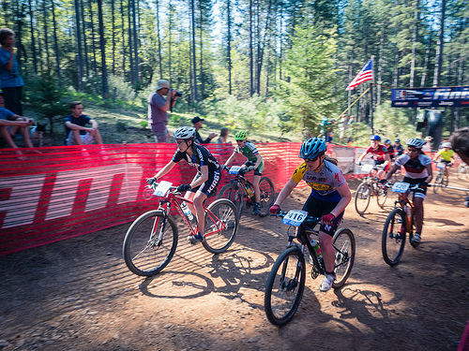
#1 its fun

Slide 6
#2 Teaches responsibility and hard work

Slide 7
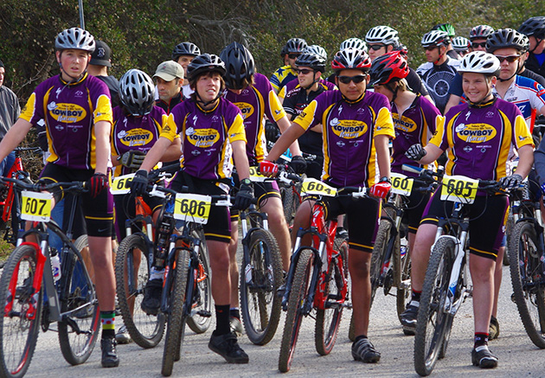
#3 Will get and keep you in shape (hard work required)

Slide 8
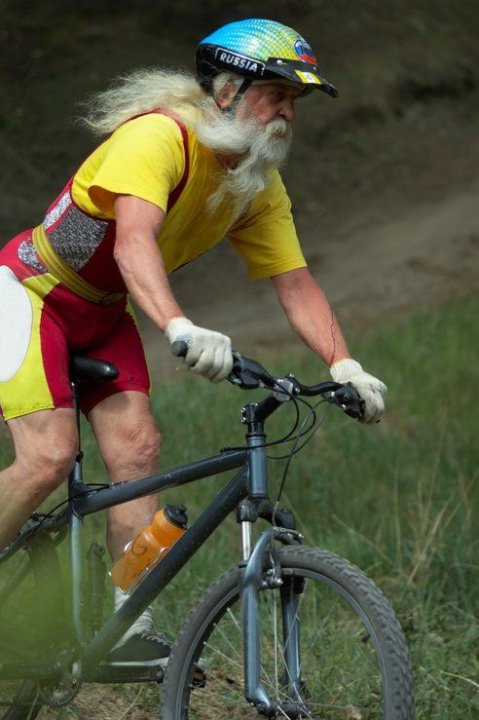
#4 Life sport and great for families

Slide 9
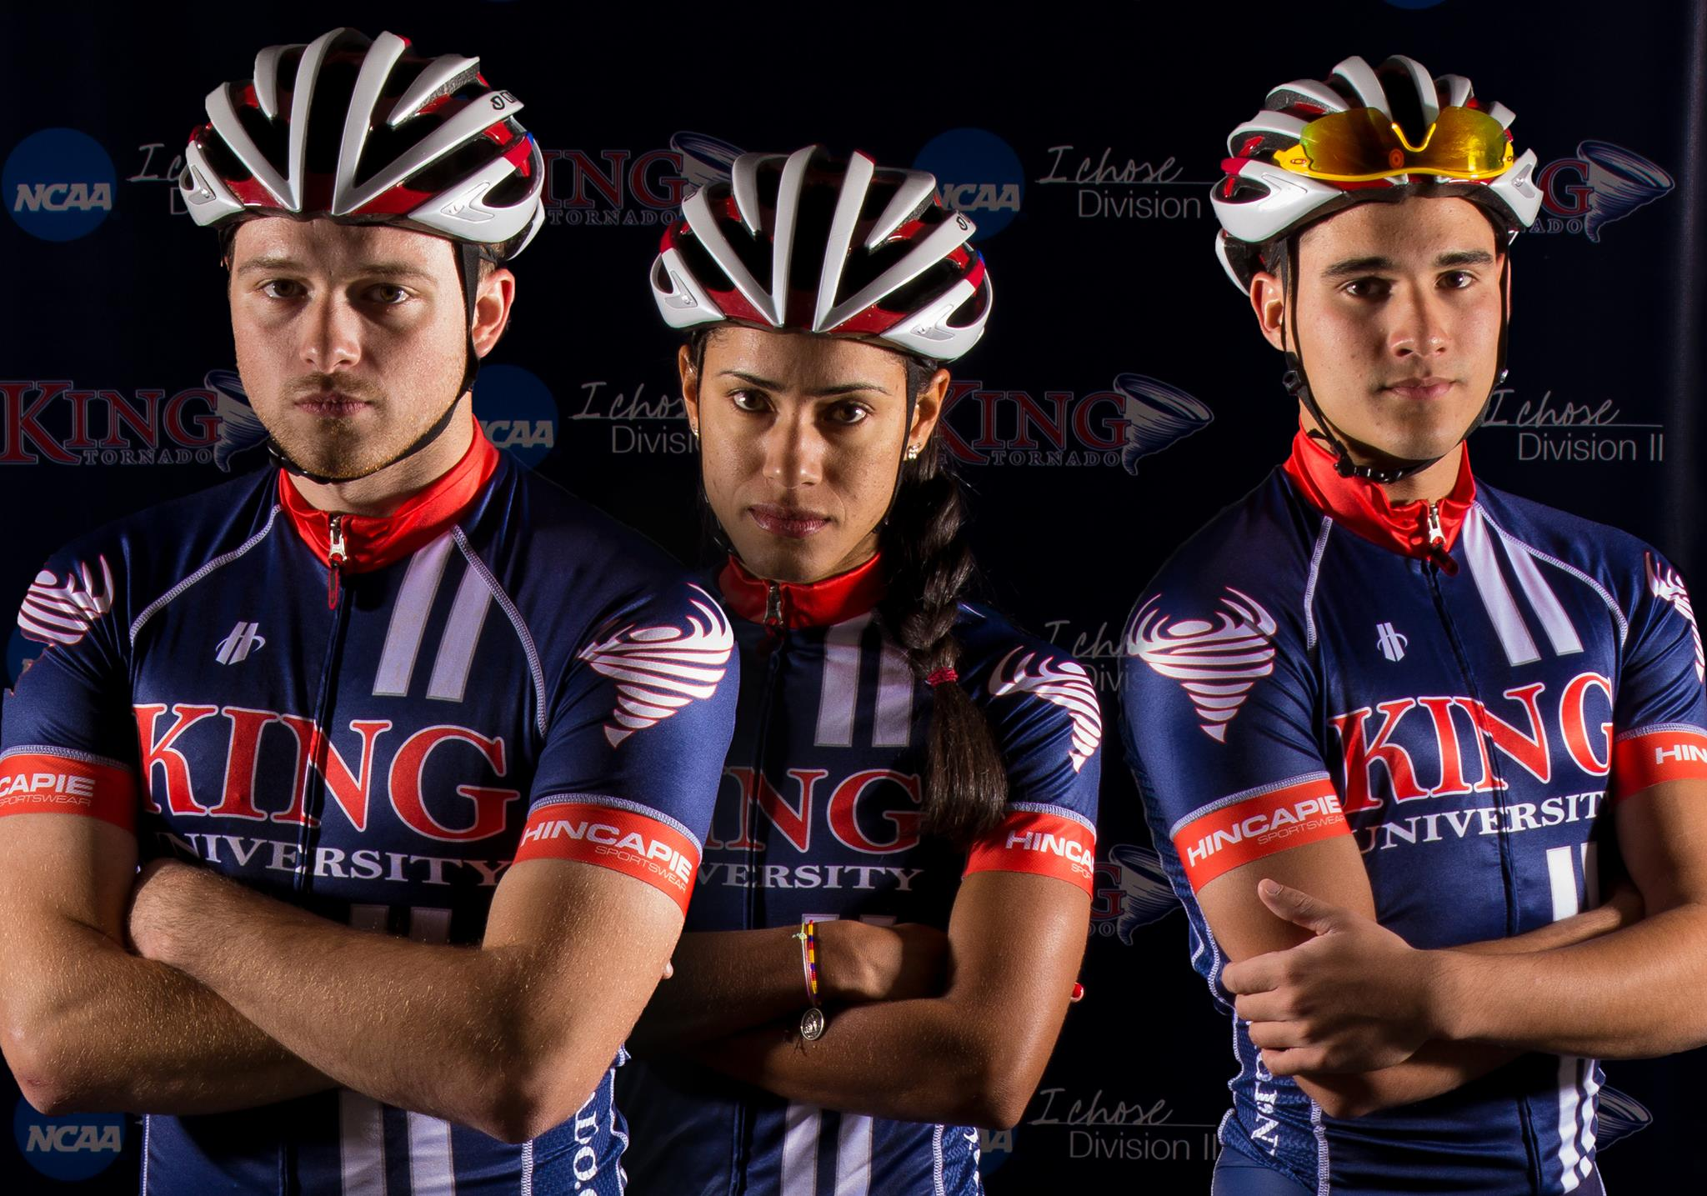
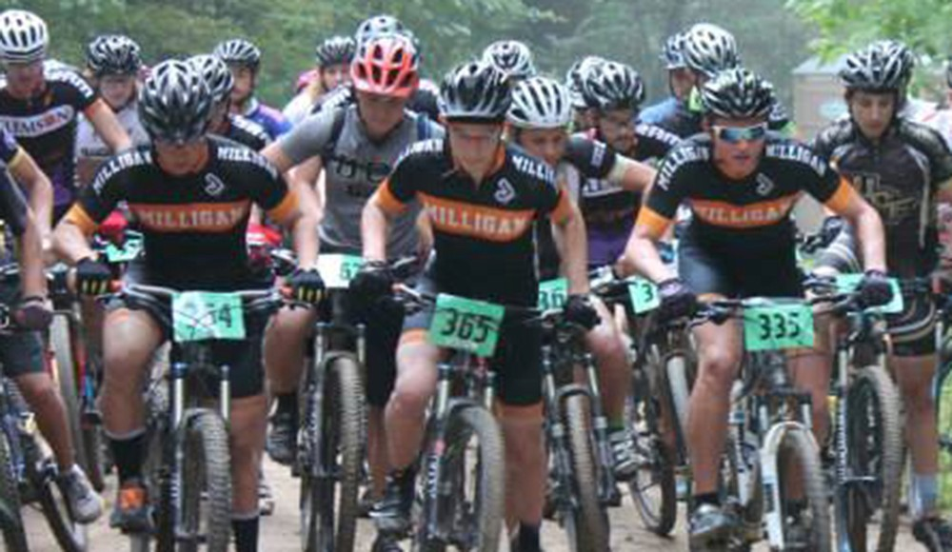
#5 Post-secondary scholarship opportunities

Slide 10
The Team

Slide 11
How its structured
NICA
TICL
Greene County Composite Team
Science Hill High School
Chattanooga teams
Nashville teams
Knoxville teams
Memphis teams
National Interscholastic Cycling Association (NICA)
Tennessee Interscholastic Cycling League (TICL)
High school ages 13-17
Co-ed team
There are lots of girls racing in the League. In fact, girl participation is the fastest growing demographic.

Slide 12
The Coach
Coach License Membership Fee for 2017
Background check
CDC Heads Up concussion training for 2017
Risk Management 1 test
Risk Management 2 test
Risk Management 3 test
NICA Student-Athlete Coaching Philosophy test
Wilderness First Aid (WFA)
CPR Certification
Field Work 80 hours required*
NICA On-the-Bike Skills Training (formerly MTB 101)
Level 3 Exam
NICA Leader Summit
Continuing Education Units (CEU) 9 units required*
NICA Coach Licensing Program

Slide 13
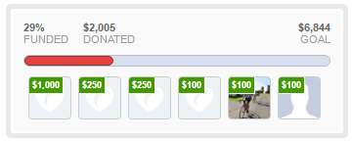
Getting started
Le Tour de Black Knight summer fundraiser goal of $6800 to start the team
Other fundraisers and sponsorships to sustain the team year-to-year
$125 Team membership fee to cover yearly TICL league dues, team expenses, etc.
Parent committee to help make team decisions and organize tasks

Slide 14
The gear

Slide 15
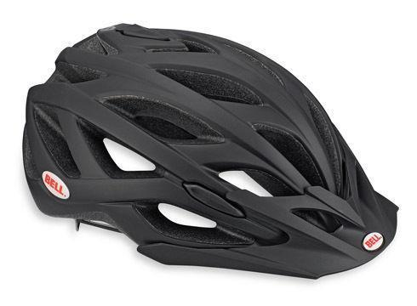
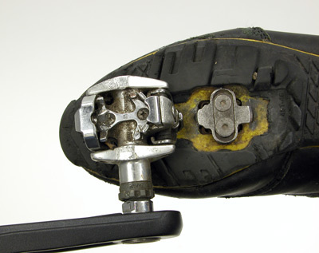
Bike – Hardtail or full suspension
Please consult me or our partner bike shops for suggestions before buying new bike
Scholarships through NICA and discount opportunities through our partners ($1000 from Trek Store of JC)
Must be checked by a coach
Helmet
Shoes – platform or clipless for experienced riders

Slide 16
Is it dangerous?

Slide 17
Specific course design (uphill starts, uphill finishes, wheels on the ground)
Wilderness First Aide
Parent riders for long rides
Physical required
Insurance required

Slide 18
The races

Slide 19
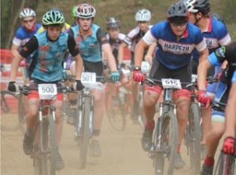
Usually 1hr-2hr races
Age/experience grouping
Chattanooga, Knoxville, Nashville, Memphis
Will caravan and carpool
Will likely camp out or stay in hotel
Parents will be expected to arrange transportation/lodging

Slide 20
The Training

Slide 21
Consistency Consistency Consistency
Gradual build up of mileage and saddle time
Ride 5-6 days a week
Summer training plan recommended
Team practice/ride 3 days a week
Tweetsie Trail, Tusculum Linear Trail, Laughlin Trail easy
Davey Crockett Birthplace SP, CDHS, Warriors Path SP, Winged Deer Park, Persimmon Ridge, Bays Mountain, Tannery Knobs intermediate
ETSU woods, Pinnacle Fire tower, Buffalo Mtn, Paint Mtn intermediate/advanced
Road rides and trips out of region possible

Slide 22
The schedule

Slide 23
August 12, 2017 First Team Meeting
August 19, 2017 First Team Practice
September 23, 2017 Race #2 Lock 4 Mountain Bike Trails Gallatin, TN
October 8, 2017 Race #3 Baker's Creek Preserve Knoxville, TN St. Andrews School MTB Trails Sewanee, TN
October 29, 2017 Race #4 St. Andrews School MTB Trails Sewanee, TN
November 12, 2017 End of Season Bash

Slide 24
Le tour de black knight

Slide 25
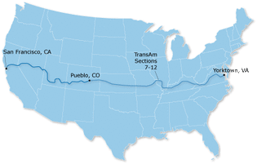
3635 miles across America
Promote
Promote youth mountain biking
Sponsors
Find team sponsors
Donations
Get donations from the community
Join
Help riders join the team

Slide 26
How to join

Slide 27
Fill out the “Rider Form”
Physical required by league
Stay in contact through e-mail/website/Facebook over the summer
Attend Team Meeting on August 12th
Pay team membership dues by September 12th
Attend practices, stay involved, and HAVE FUN

Slide 28
Noah Naseri:
Le Tour de Black Knight:
Team:
Facebook group
Website coming soon
noah.naseri@gmail.com
www.rideforkids2017.weebly.com
@rideforkids2017
@rideforkids2017

Slide 29
Questions?

